Slide 1
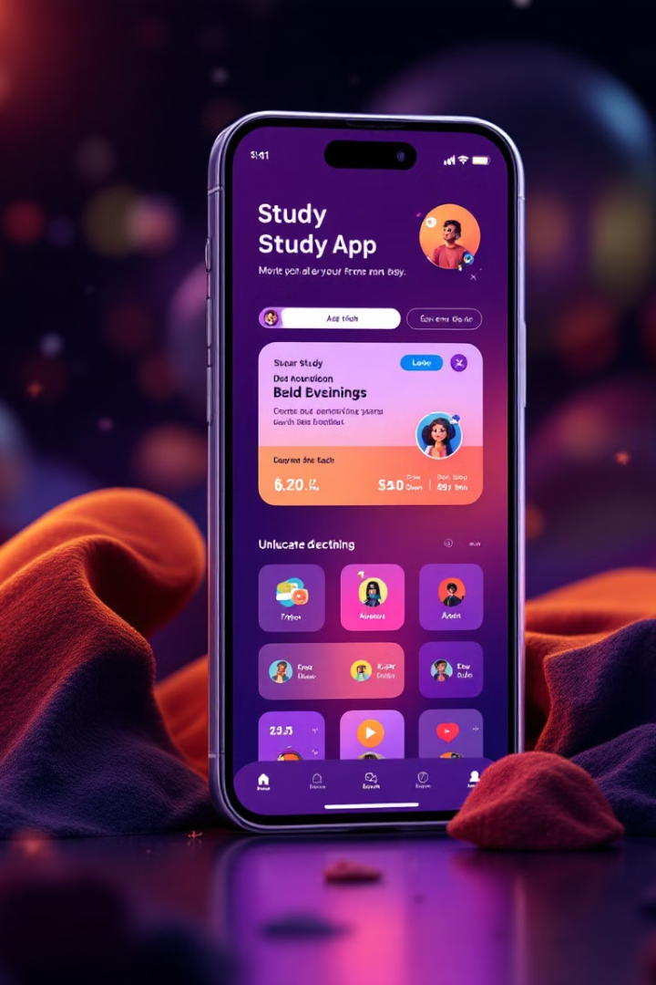
OWL-M: A Material Design Study App
K.Renuga -00CF57C7F307217AC7744E00D0A9DC35
M.Jona princy -16FF9CFB6971DEBB5B64956F5F6DC399
K.Rubini -18FADD785BC54AE8D46445A5BC3179B5
S.Arthi -100B1C791570314B0D6419D055B196CA
R.Nivetha – 1346E98F5AE1F35834E43020B575CA69

Slide 2

Importance of UI/UX in Educational Apps
1
User-Friendliness
2
Engagement and Motivation
A well-designed UI/UX makes the learning process more accessible and enjoyable for students.
An intuitive interface with interactive elements can encourage students to actively participate in their learning.
3
Learning Outcomes
A thoughtfully designed educational app can positively impact student comprehension and retention of information.

Slide 3
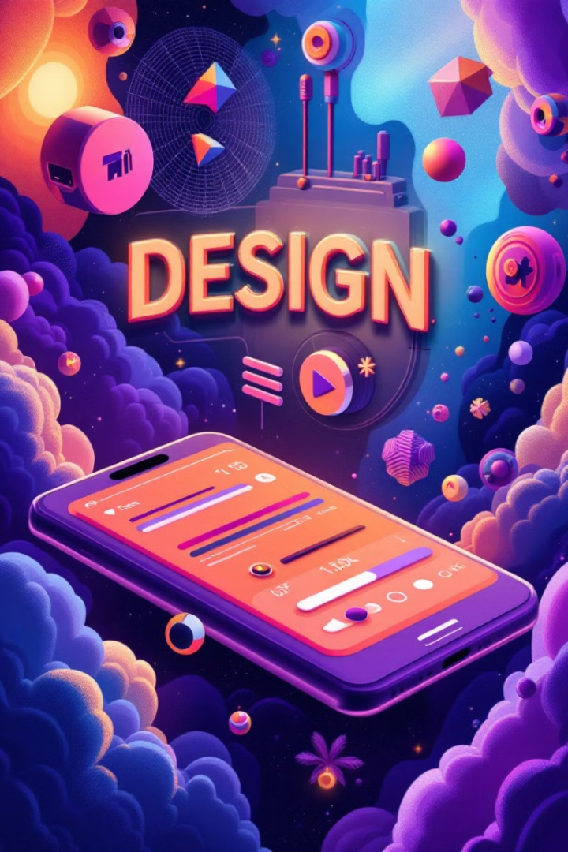
Material Design Principles
Materiality
Motion
Material Design leverages the metaphor of physical objects to create a tangible and intuitive user experience.
Animations and transitions are used to create a sense of fluidity and responsiveness, making the app feel dynamic.
Color
A carefully chosen color palette enhances brand identity, improves readability, and guides user attention.

Slide 4
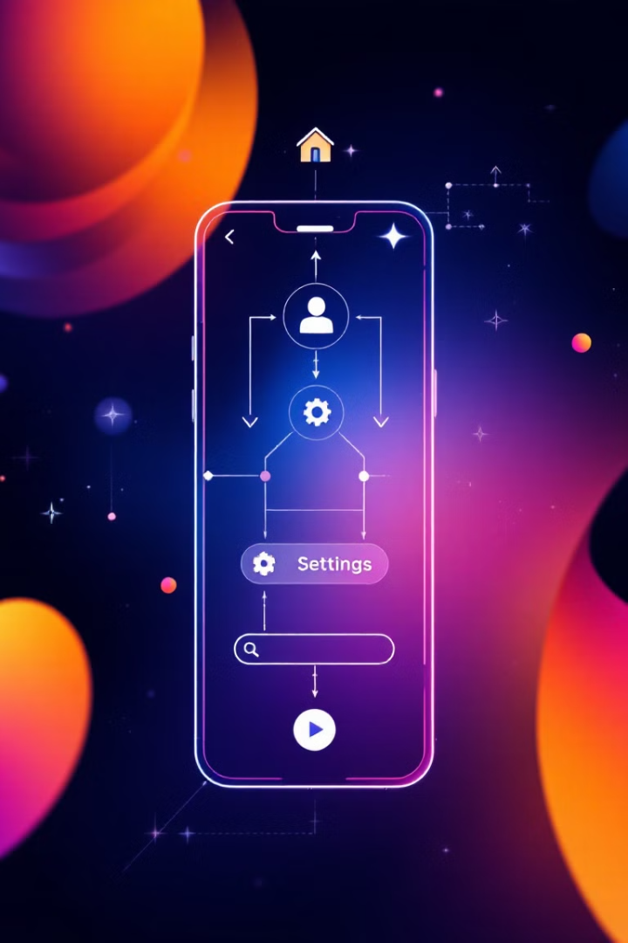

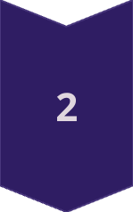
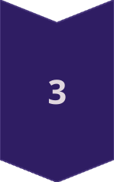
Navigational Structure
Home Screen
The starting point for users, providing access to key features and personalized content.
Course Catalog
A searchable list of courses categorized by subject, level, and other criteria.
Lesson Pages
Detailed information on each lesson, including interactive elements, videos, and assessments.

Slide 5
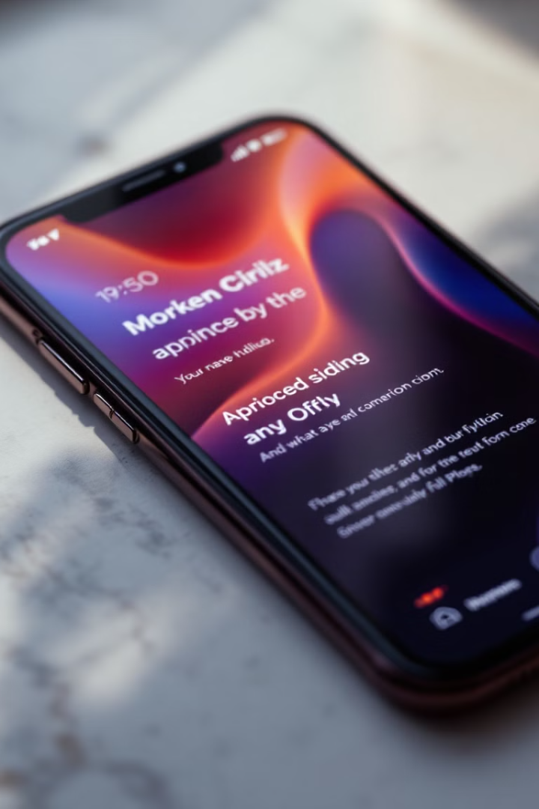
Typography and Color Palette
Typography
Roboto
Color Palette
Blue, Green, Yellow, Red

Slide 6
Interaction Design
Gestures
Feedback
Accessibility
Swiping, tapping, and long pressing are used to navigate the app and interact with content.
Visual cues and animations are used to provide clear feedback on user actions, enhancing usability.
The design considers users with disabilities by providing alternative input methods and clear visual contrast.

Slide 7
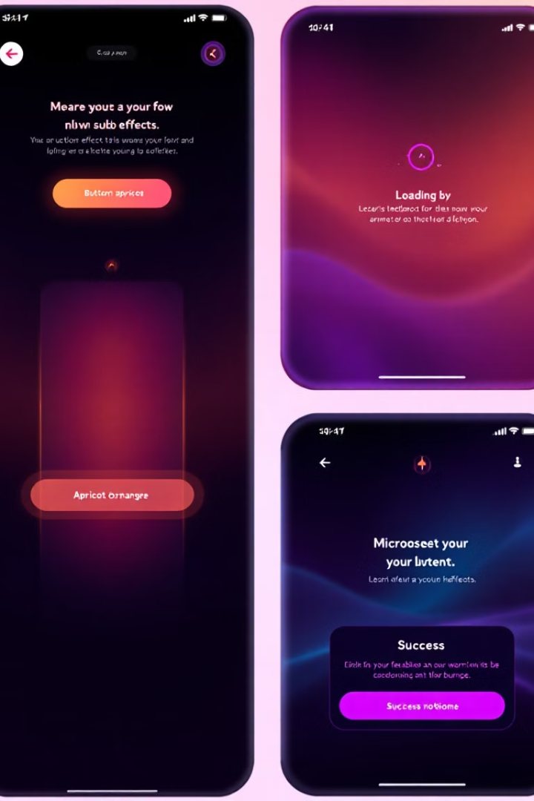




Animations and Microinteractions
Loading Indicators
Menu Animations
Visual feedback during loading times keeps users engaged and informed.
Smooth animations enhance the experience of opening and closing menus.
Progress Bars
Success Feedback
Visual representation of user progress through a course provides motivation and encourages completion.
Positive feedback for correct answers reinforces learning and encourages continued engagement.

Slide 8
<?xml version="1.0" encoding="utf-8"?>
<androidx.cardview.widget.CardView xmlns:android="http://schemas.android.com/apk/res/android" xmlns:app="http://schemas.android.com/apk/res-auto"
xmlns:tools="http://schemas.android.com/tools" android:layout_width="match_parent"
android:layout_height="wrap_content“
app:cardCornerRadius="8dp" app:cardElevation="4dp" tools:context=".MaterialItemActivity">
<LinearLayout android:layout_width="match_parent"
android:layout_height="wrap_content"
android:orientation="vertical" android:padding="16dp">
<TextView android:id="@+id/titleText"
android:layout_width="wrap_content"
android:layout_height="wrap_content"
android:text="Material Title"
android:textStyle="bold"
android:textSize="18sp" />
<TextView android:id="@+id/descriptionText"
android:layout_width="wrap_content“
android:layout_height="wrap_content" android:text="Material Description"
android:textSize="14sp" android:layout_marginTop="8dp" />
</LinearLayout> </androidx.cardview.widget.CardView>

Slide 9
public class MaterialAdapter extends RecyclerView.Adapter<MaterialAdapter.MaterialViewHolder>
{
private List<StudyMaterial> materialList; public MaterialAdapter(List<StudyMaterial> materialList)
{
this.materialList = materialList;
}
@Override public MaterialViewHolder onCreateViewHolder(ViewGroup parent, int viewType)
{
View view = LayoutInflater.from(parent.getContext()) .inflate(R.layout.item_material, parent, false);
return new MaterialViewHolder(view); }
@Override public void older, int position)
{
StudyMaterial material = materialList.get(position);
holder.titleText.setText(material.getTitle());
holder.descriptionText.setText(material.getDescription());
}
@Override public int getItemCount()
{
return materialList.size();
}
public static class MaterialViewHolder extends RecyclerView.ViewHolder
{
TextView titleText, descriptionText;
public MaterialViewHolder(View itemView)
{
super(itemView);
titleText = itemView.findViewById(R.id.titleText);
descriptionText = itemView.findViewById(R.id.descriptionText);
}
}
}

Slide 10
public class MaterialAdapter extends RecyclerView.Adapter<MaterialAdapter.MaterialViewHolder>
{ private List<StudyMaterial> materialList; public MaterialAdapter(List<StudyMaterial> materialList)
{
this.materialList = materialList;
}
@Override public MaterialViewHolder onCreateViewHolder(ViewGroup parent, int viewType)
{ View view = LayoutInflater.from(parent.getContext()) .inflate(R.layout.item_material, parent, false);
return new MaterialViewHolder(view);
}
@Override public void onBindViewHolder(MaterialViewHolder holder, int position)
{ StudyMaterial material = materialList.get(position); holder.titleText.setText(material.getTitle()); holder.descriptionText.setText(material.getDescription());
}
@Override public int getItemCount()
{
return materialList.size();
}
public static class MaterialViewHolder extends RecyclerView.ViewHolder
{
TextView titleText, descriptionText; public MaterialViewHolder(View itemView)
{
super(itemView); titleText = itemView.findViewById(R.id.titleText);
descriptionText = itemView.findViewById(R.id.descriptionText); } } }

Slide 11
4. Examples of Key Screens in the Study App
Home Screen
App Bar with the app name, a search bar, and menu options.
Category Grid or list to choose subjects or topics.
Study Material Cards for each topic or material.
Progress Overview showing the user’s current progress.

Slide 12
Quiz Screen
Multiple-choice Questions with options that users can select.
Next/Previous Buttons to navigate through the questions.
Timer showing the time remaining in the quiz.
Submit Button that triggers the score feedback.
Progress Screen
Visual Progress Tracker like a circular progress bar or pie chart.
Completed Materials with checkmarks or highlights.
Achievements & Badges to encourage continued learning.

Slide 13

Conclusion and Next Steps
A well-designed Material Design Study App has the potential to significantly enhance the learning experience for students.
The next steps include implementing the design, conducting user testing, and iterating based on user feedback.

